Slide 1
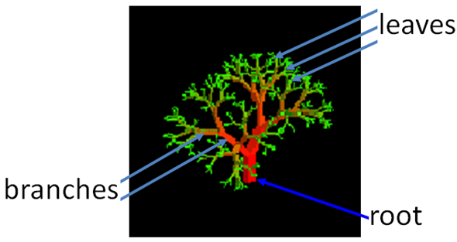
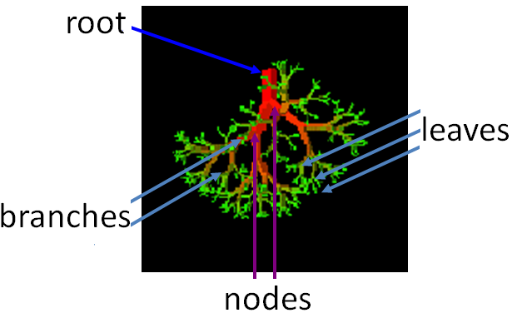
Nature View
TREE
Computer Scientist’s View

Slide 2
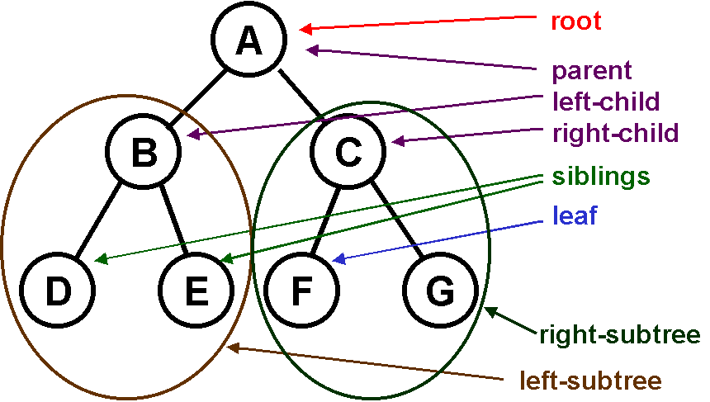
What is a Tree
A tree is a finite nonempty set of elements.
It is an abstract model of a hierarchical structure, consists of nodes with a parent-child relation.
Applications: Programming environments, Organization charts , File systems.

Slide 3
Tree Terminology
A
B
C
D
Root: node without parent (A)
Siblings: nodes share the same parent
Internal node: node with at least
one child (A, B, C, F)
External node (leaf ): node without children
(E, I, J, K, G, H, D)
Ancestors of a node: parent, grandparent, grand-grandparent, etc.
Descendant of a node: child, grandchild, grand-grandchild, etc.
Depth of a node: number of ancestors
Height of a tree: maximum depth of any node (3)
Degree of a node: the number of its children
Degree of a tree: the maximum number of its node.
Subtree: Tree consisting of a node and its descendants.
E
F
G
H
I
J
K

Slide 4
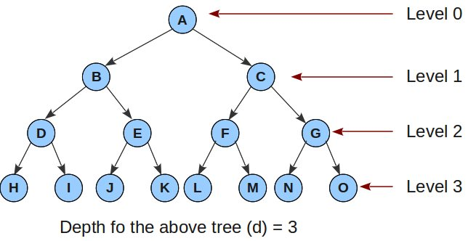
Levels and Height of tree
Root is at level 0 and its children are at level 1.
Height = depth = number of levels
Each node has to be reachable from the roots through a unique sequence of arcs called a path.
The number of arcs in a path is called the length of the path.

Slide 5
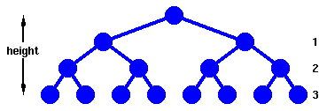
Binary Tree
A binary tree is a tree with the following properties:
Each internal node has at most two children (degree of two)
The children of a node are an ordered pair
Applications :
arithmetic expressions
decision processes
searching

Slide 6
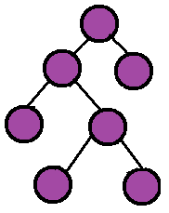
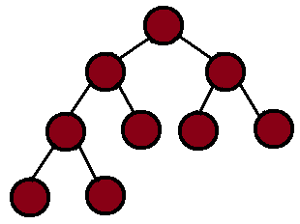
Complete v/s Full Binary Tree
A complete binary tree is one where all the levels are full with exception to the last level and it is filled from left to right.
A full binary tree is one where if a node has a child, then it has two children.

Slide 7


Skewed Binary Tree
A binary tree which is dominated solely by left child nodes or right child nodes is called a skewed binary tree.
Left
Skewed
Right
Skewed

Slide 8
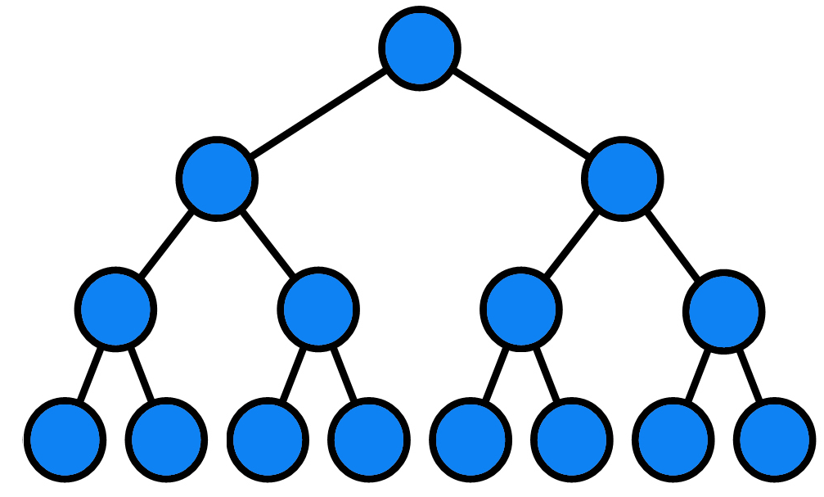
Maximum Number of Nodes in a Binary Tree
The maximum nubmer of nodes in a binary tree of height k is 2^{k+1}-1, k>=0.

Slide 9
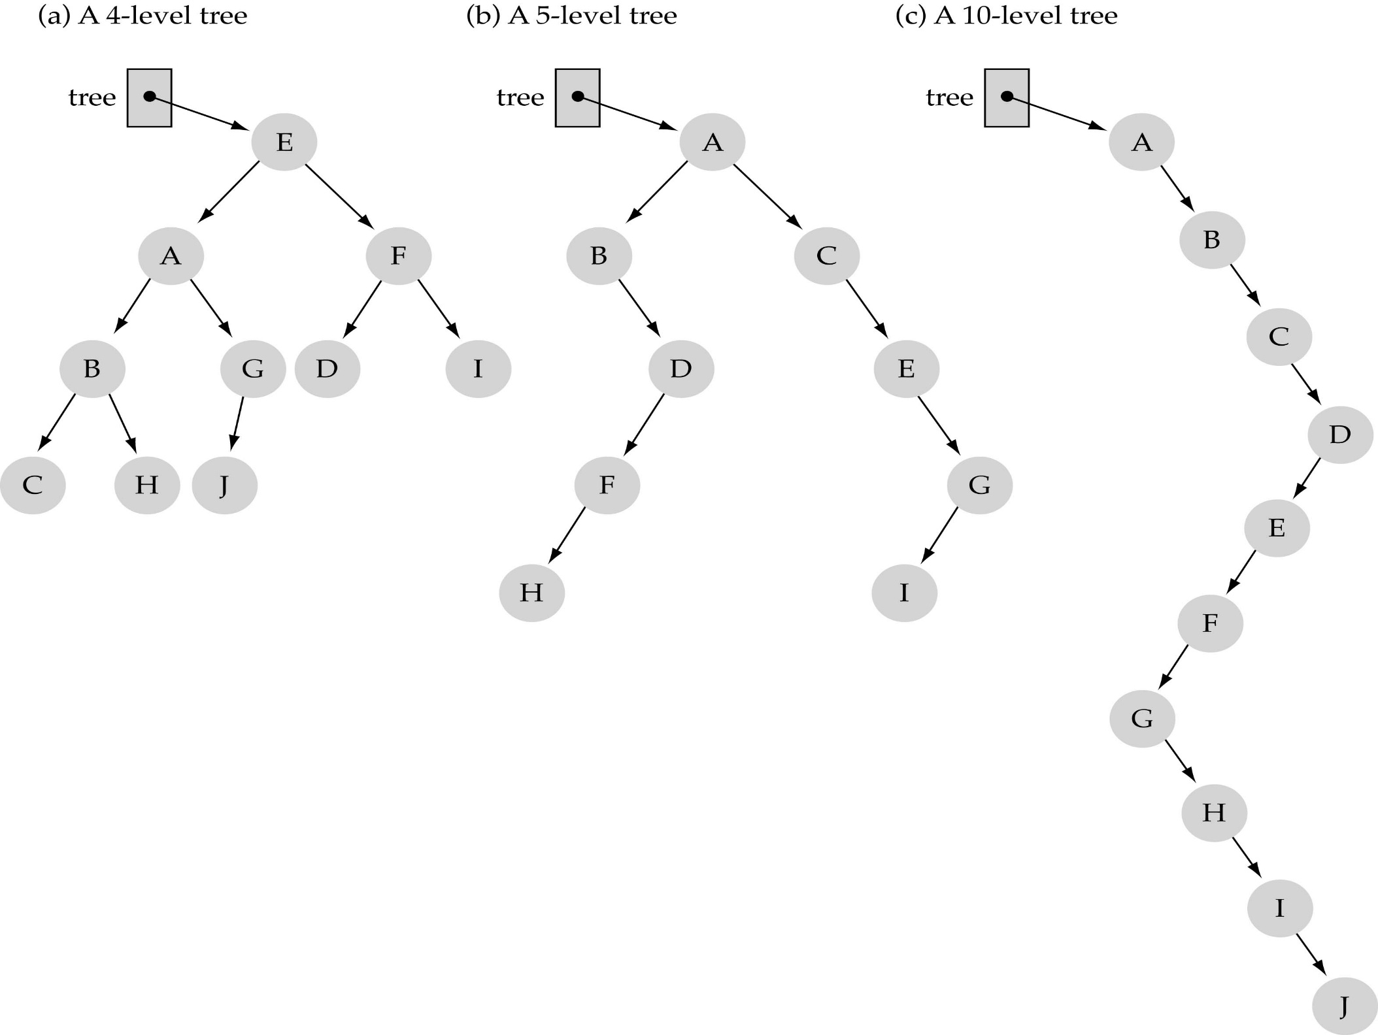
Max height of a tree with N nodes
N (same as a linked list)
Min height of a tree with N nodes
log(N+1)

Slide 10
Binary Tree Representation
Array representation
Linked representation

Slide 11
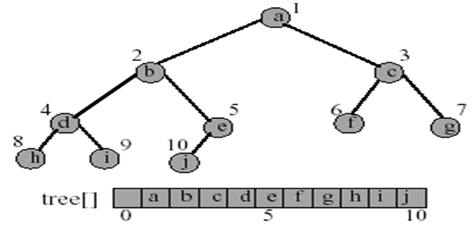
Array Representation of Binary Tree
The binary tree is represented in an array by storing each element at the array position corresponding to the number assigned to it.

Slide 12
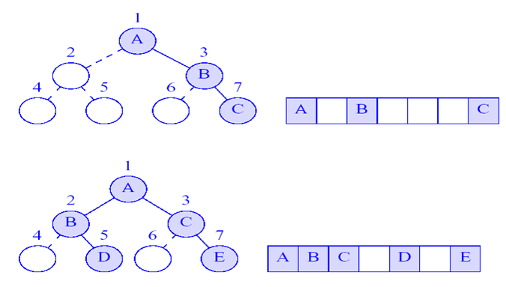
Incomplete Binary Trees

Slide 13
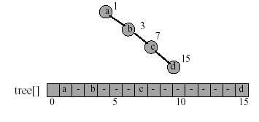
Right-Skewed Binary Tree
An n node binary tree needs an array whose length is between n+1 and 2^{n}.
Right-skewed binary tree wastes the most space
What about left-skewed binary tree?

Slide 14
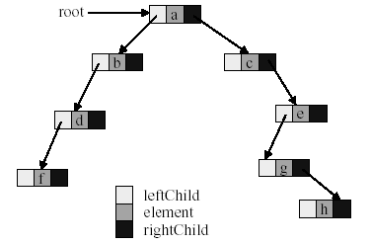
Linked Representation of Binary Tree

Slide 15
Data Structure for Binary Trees
A node is represented by an object storing
Element
Parent node
Left child node
Right child node
∅
B
∅
∅
B
A
D
A
D
∅
∅
∅
∅
C
E
C
E

Slide 16
Arithmetic Expression Tree
Binary tree associated with an arithmetic expression
internal nodes: operators
external nodes: operands
Example: arithmetic expression tree for the expression (2 × (a - 1) + (3 × b))
+
×
×
2
−
3
b
a
1

Slide 17
Decision Tree
Binary tree associated with a decision process
internal nodes: questions with yes/no answer
external nodes: decisions
Example:
A > B
Yes
No
A > C
B > C
Yes
No
Yes
No
A is Max
C is Max
B is Max
C is Max

Slide 18
Tree Traversals
There are mainly three ways to traverse a tree:
Inorder Traversal : Left -> Root -> Right
Preorder Traversal : Root -> Left -> Right
Postorder Traversal : Left -> Right -> Root

Slide 19
Inorder Traversal: A E H J M T Y
Algorithm inOrder(v)
if isInternal (v)
inOrder (leftChild (v))
visit(v)
if isInternal (v)
inOrder (rightChild (v))
Visit second
tree
‘J’
‘E’
‘T’
‘A’
‘H’
‘M’
‘Y’
Visit left subtree first
Visit right subtree last

Slide 20
Preorder Traversal: J E A H T M Y
Visit first
tree
‘J’
‘E’
‘T’
‘A’
‘H’
‘M’
‘Y’
Visit left subtree second
Visit right subtree last

Slide 21
Postorder Traversal: A H E M Y T J
Visit last
tree
‘J’
‘E’
‘T’
‘A’
‘H’
‘M’
‘Y’
Visit left subtree first
Visit right subtree second

Slide 22
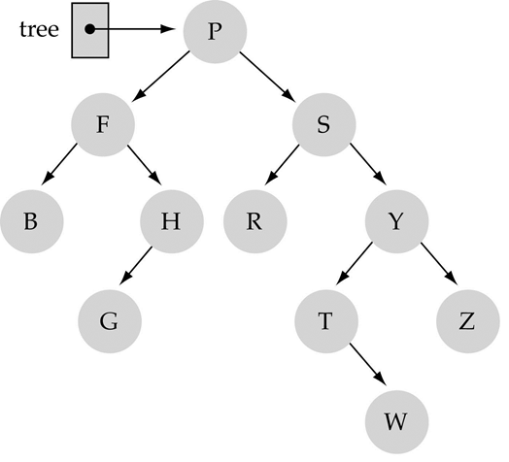
Tree Traversals: another example
Inorder : B F G H P R S T W Y Z
Preorder : P F B H G S R Y T W Z
Postorder : B G H F R W T Z Y S P

Slide 23
Print Arithmetic Expressions
Specialization of an inorder traversal
print operand or operator when visiting node
print “(“ before traversing left subtree
print “)“ after traversing right subtree
Algorithm inOrder (v)
if isInternal (v){ print(“(’’)
inOrder (leftChild (v))}
print(v.element ())
if isInternal (v){
inOrder (rightChild (v))
print (“)’’)}
+
×
×
2
−
3
b
((2 × (a − 1)) + (3 × b))
a
1

Slide 24
Evaluate Arithmetic Expressions
recursive method returning the value of a subtree
when visiting an internal node, combine the values of the subtrees
Algorithm evalExpr(v)
if isExternal (v)
return v.element ()
else
x ← evalExpr(leftChild (v))
y ← evalExpr(rightChild (v))
◊ ← operator stored at v
return x ◊ y
+
×
×
2
−
3
2
5
1

Slide 25

How to search a binary tree?
(1) Start at the root
(2) Search the tree level
by level, until you find
the element you are
searching for or you reach
a leaf.
Is this better than searching a linked list?
No → O(N)

Slide 26
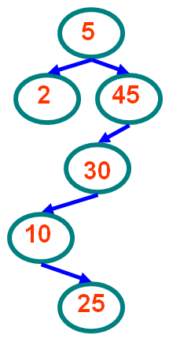
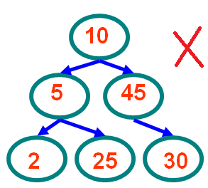
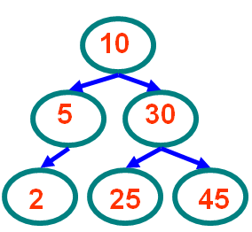

Binary Search Trees
A binary search tree (BST) is a binary tree that has the following property: For each node n of the tree, all values stored in its left subtree are less than value v stored in n, and all values stored in the right subtree are greater than v, i.e., the value stored at the root of a subtree is greater than any value in its left subtree and less than any value in its right subtree.

Slide 27
How to search a binary search tree?
(1) Start at the root
(2) Compare the value of the item you are searching for with the value stored at the root
(3) If the values are equal, then item found; otherwise, if it is a leaf node, then not found
4) If it is less than the value stored at the root, then search the left sub-tree
(5) If it is greater than the value stored at the root, then search the right sub-tree
(6) Repeat steps 2-6 for the root of the sub-tree chosen in the previous step 4 or 5

Slide 28
Recursive Find
Node *
find(Comparable key, Node * t)
{
if (t == NULL)
return t;
else if (key < t->key)
return find(key, t->left);
else if (key > t->key)
return find(key, t->right);
else
return t;
}
10
5
15
2
9
20
7
17
30
Notes:
Now, let’s try finding a node.
Find 9.
This time I’ll supply the code.
This should look a _lot_ like binary search!
How long does it take?
Log n is an easy answer, but what if the tree is very lopsided?
So really, this is worst case O(n)!
A better answer is theta of the depth of the node sought.
If we can bound the depth of that node, we can bound the length of time a search takes.

Slide 29
Iterative Find
Node *
find(Comparable key, Node * t)
{
while (t != NULL && t->key != key)
{
if (key < t->key)
t = t->left;
else
t = t->right;
}
return t;
}
10
5
15
2
9
20
7
17
30

Slide 30
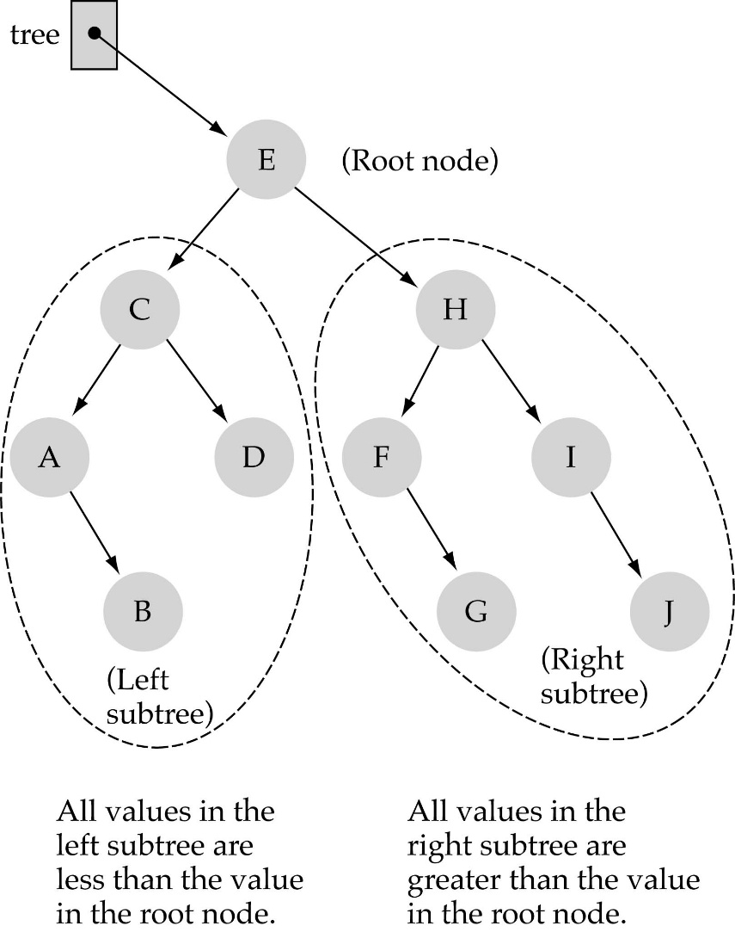
How to search a binary search tree?
Is this better than searching
a linked list?
Yes !! ---> O(logN)

Slide 31
Finding Min & Max
The binary-search-tree property guarantees that:
The minimum is located at the left-most node.
The maximum is located at the right-most node.
Tree-Minimum(x) Tree-Maximum(x)
1. while t->left ≠ NULL 1. while t->right≠ NULL
do t=t->left 2. do t=t->right
return t 3. return t

Slide 32
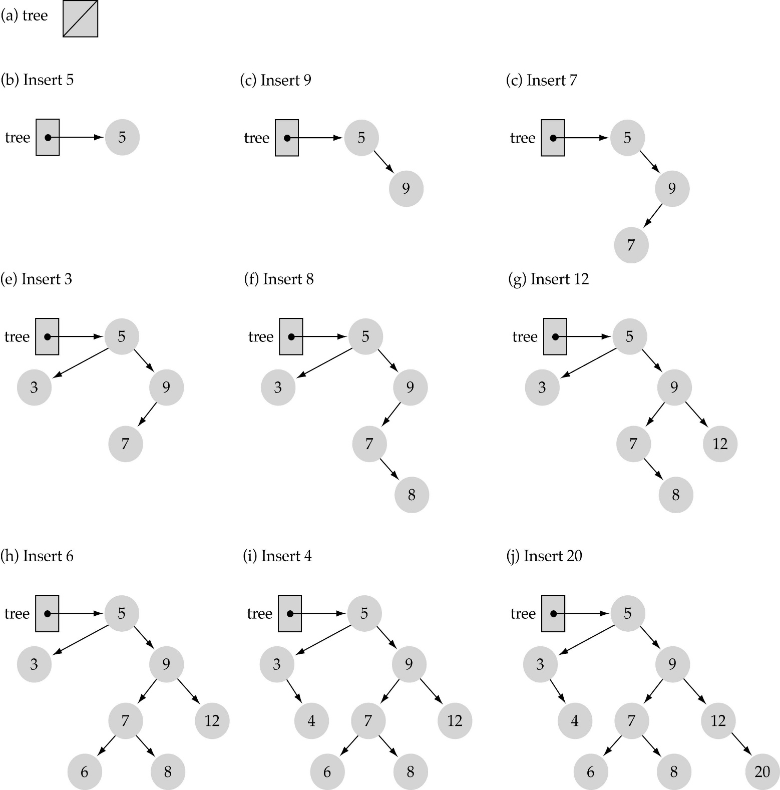
Insertion in Binary Search Tree
Use the binary search tree property to insert the new item at the correct place

Slide 33
Algo & Analysis of Insertion in BST
Tree-Insert(T, z)
y ← NIL
x ← root[T]
while x ≠ NIL
do y ← x
if key[z] < key[x]
then x ← left[x]
else
x ← right[x]
p[z] ← y
if y = NIL
then root[t] ← z
else if key[z] < key[y]
then left[y] ← z
else right[y] ← z
Initialization: O(1)
While loop in lines 3-7 searches for place to insert z, maintaining parent y. This takes O(h) time.
Lines 8-13 insert the value: O(1)
⇒ TOTAL: O(h) time to insert a node.

Slide 34
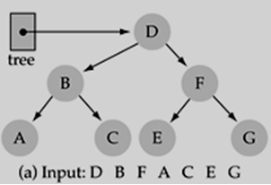
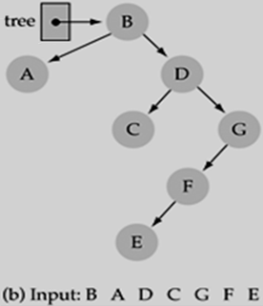
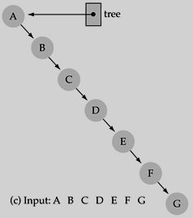
Does the order of inserting elements into a tree matter?
Yes, certain orders might produce very unbalanced trees which are not desirable because search time increases!

Slide 35
Successor Node
Next larger node
in this node’s subtree
10
Node * succ(Node * t) {
if (t->right == NULL)
return NULL;
else
return min(t->right);
}
5
15
2
9
20
7
17
30
Notes:
Here’s a little digression.
Maybe it’ll even have an application at some point.
Find the next larger node in 10’s subtree.
Can we define it in terms of min and max?
It’s the min of the right subtree!

Slide 36
Predecessor Node
Next smaller node
in this node’s subtree
10
Node * pred(Node * t) {
if (t->left == NULL)
return NULL;
else
return max(t->left);
}
5
15
2
9
20
7
17
30
Notes:
Predecessor is just the mirror problem.

Slide 37
Deletion from BST
First, find the item; then, delete it
Binary search tree property must be preserved!!
We need to consider three different cases:
(1) Deleting a leaf
(2) Deleting a node with only one child
(3) Deleting a node with two children

Slide 38
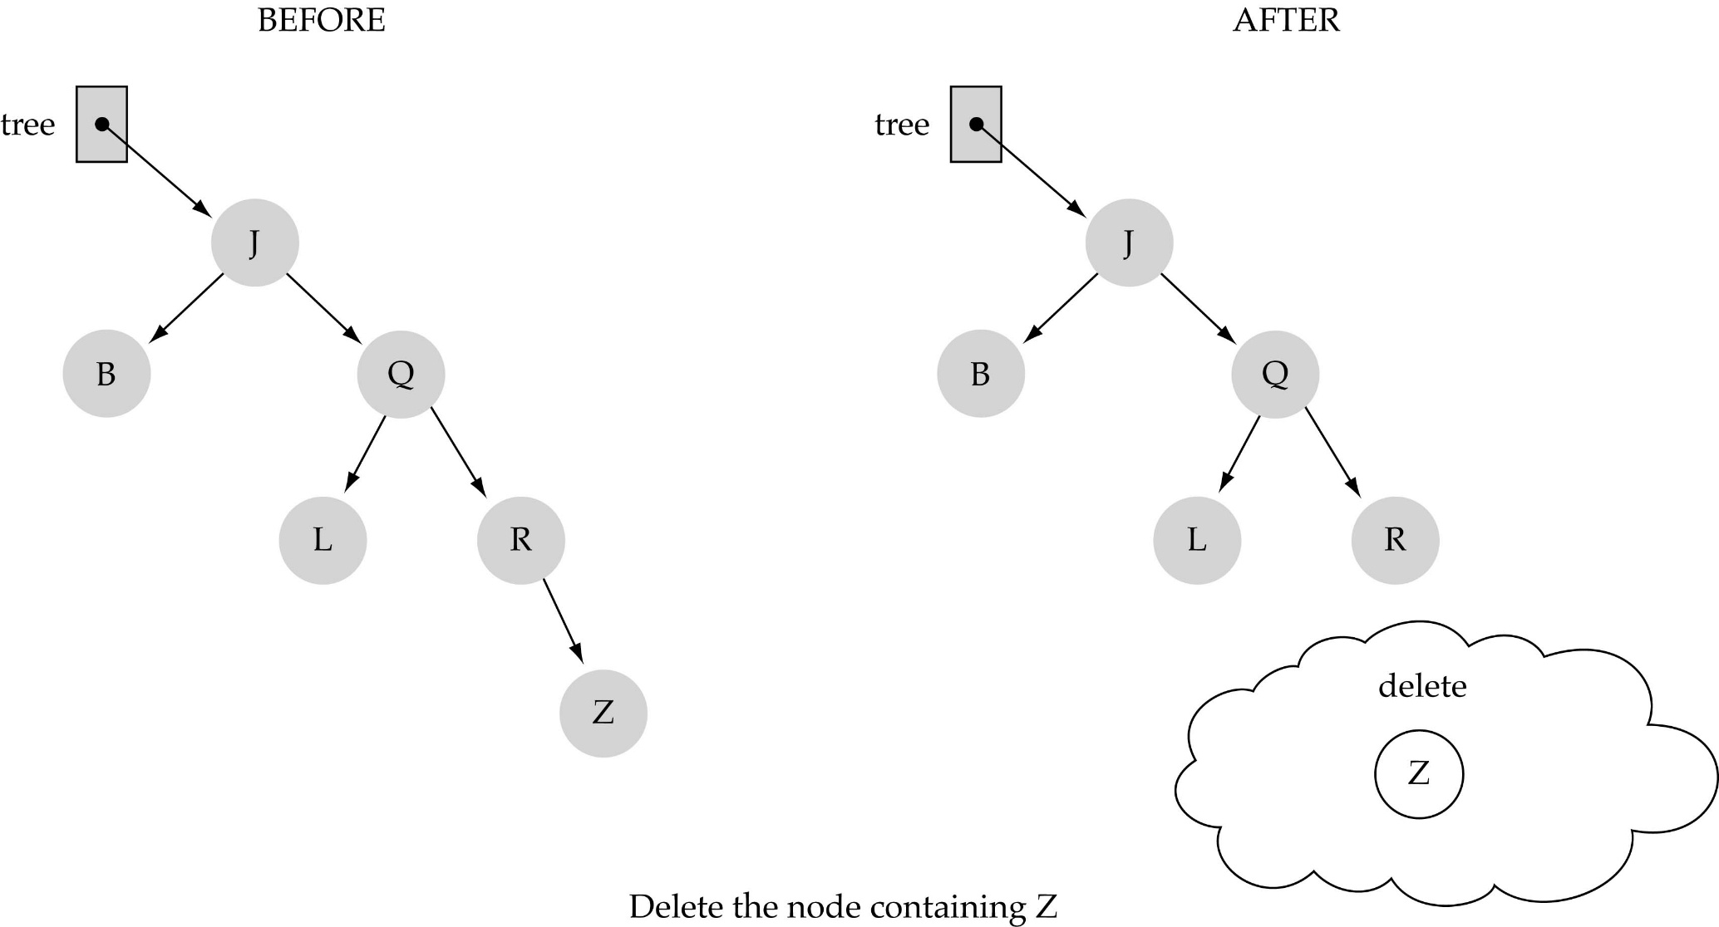
(1) Deleting a leaf

Slide 39
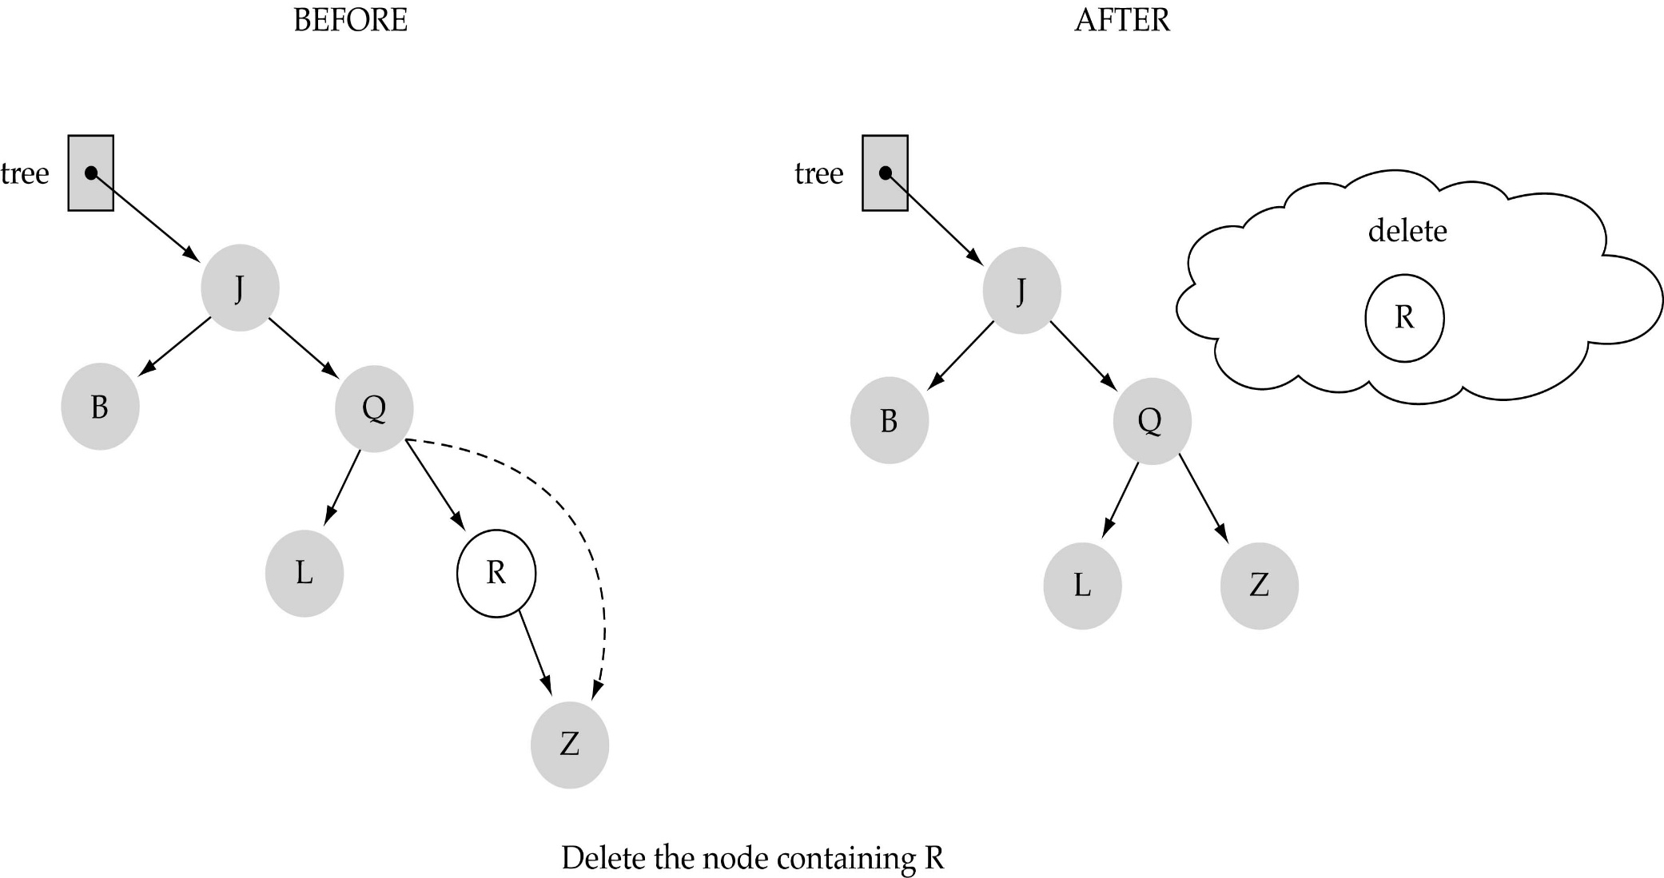
(2) Deleting a node with only one child

Slide 40
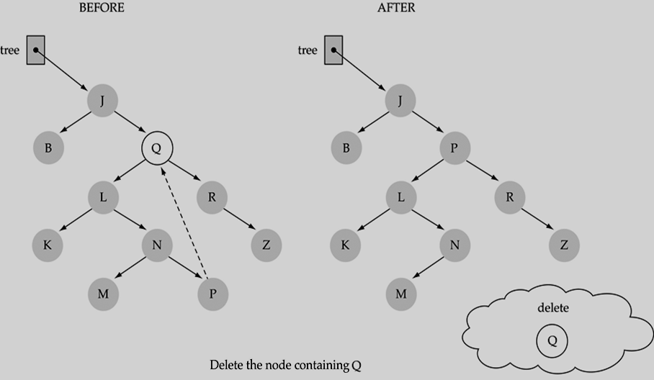
(3) Deleting a node with two children

Slide 41
(3) Deleting a node with two children (continued.)
Find predecessor (i.e., rightmost node in the left subtree)
Replace the data of the node to be deleted with predecessor's data
Delete predecessor node

